Slide 1



Movie Rental Analytics

Slide 2


Objectives
Identify top rented films
Analyze store performance
Detect rental and revenue patterns

Slide 3
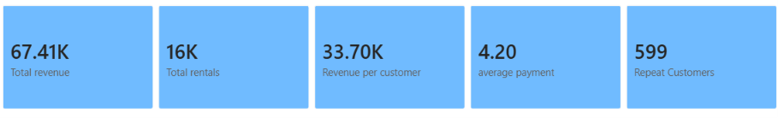
Key Metrics
Total Revenue
Total Rentals
Total Customers
Total Films
Average Rental Rate

Slide 4
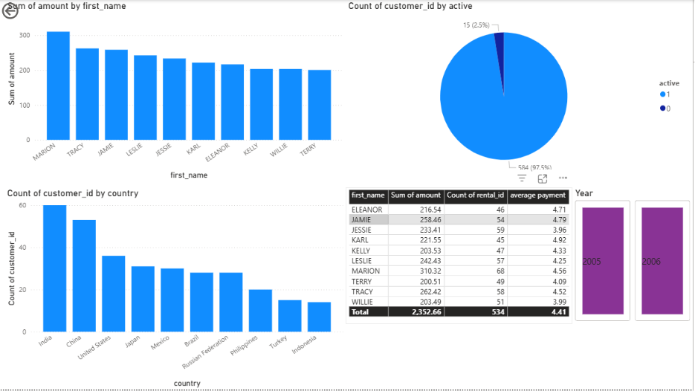

Customer Insights
- Repeat customers contribute more revenue than new customers
- High-value customers generate consistent rentals
- Customer activity varies across regions
- Active customers show higher average spending

Slide 5
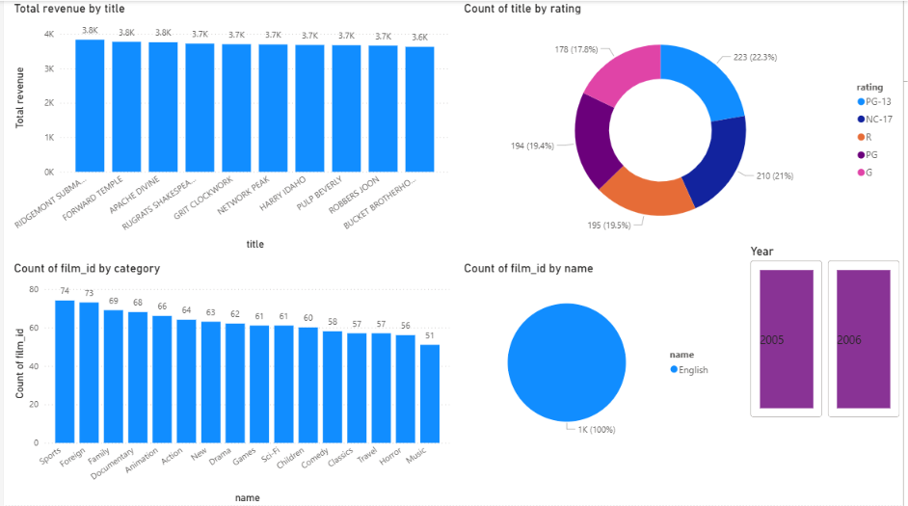
Film Insights
Action and Comedy films are rented the most
Certain film categories generate majority of revenue
Some films have low demand and low profitability
High rental rate films provide better returns

Slide 6
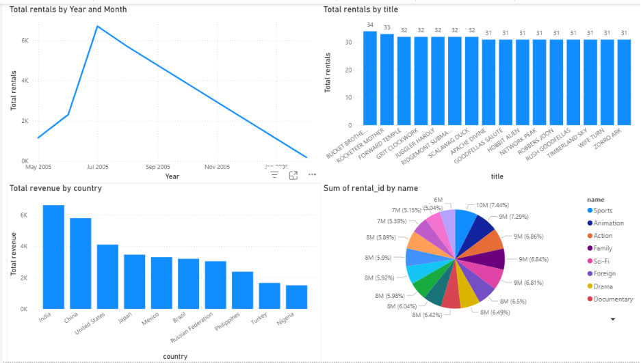
Rental Insights
Rental activity shows clear monthly and seasonal trends
Weekends and holidays record higher rental volumes
Certain films are rented significantly more frequently than others
Action, Comedy, and Family categories generate maximum rentals

Slide 7

Key Problems Identified
Rental inconsistency across months
Low-performing stores and regions
Excess inventory for low-demand films
Weak customer retention in some segments
Uneven staff performance

Slide 8
Solutions
Introduce seasonal offers during low rental periods
Improve marketing in low-performing regions
Optimize inventory for popular film categories
Launch loyalty programs for repeat customers
Train staff to improve operational efficiency

Slide 9
Recommendations
Focus on high-demand film categories
Improve customer engagement strategies
Expand services in high-performing regions
Optimize pricing based on rental demand
Use data-driven decision making for inventory planning

Slide 10
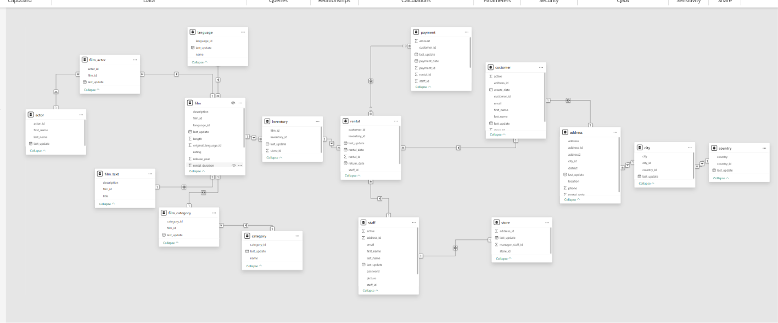

Slide 11

Conclusion
Analytics helps improve rental business performance
Customer and film insights increase profitability
Store and staff analysis improves operational efficiency
Continuous monitoring supports business growth

